Slide 1

SPRINT-1
Ecommerce
Guidance by- Vikas Verma
Presented by-Sayali shewale

Slide 2
Contents
Flow Diagram
Features

Slide 3
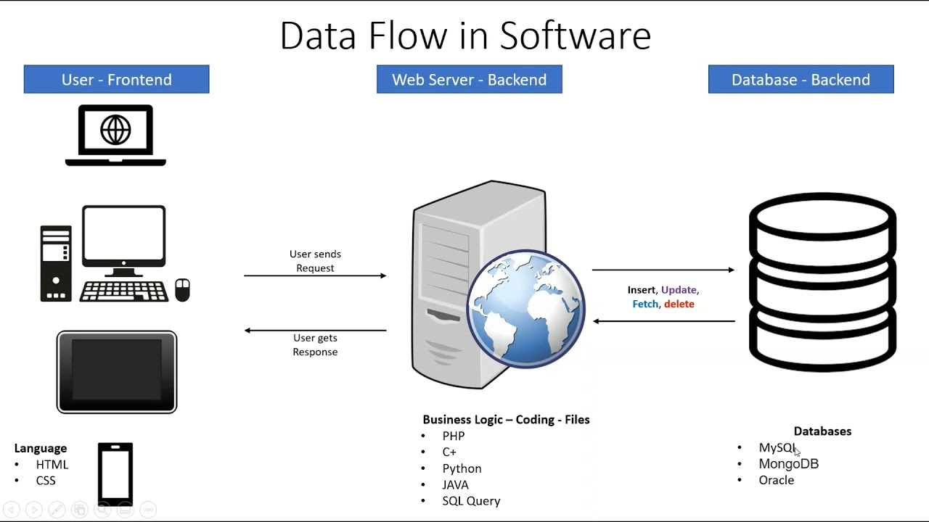

Slide 4
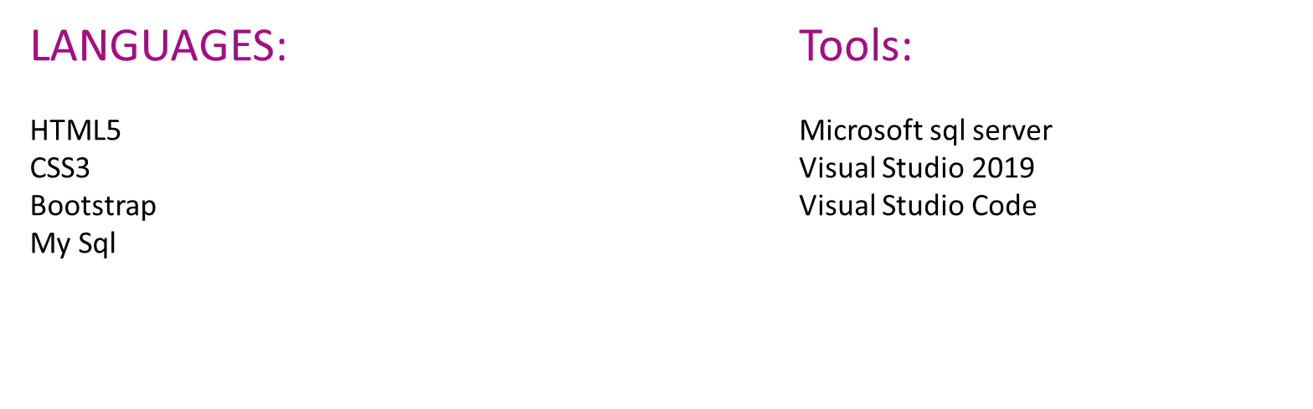

Slide 5
Features
Creation of ASP. Net core web API
Implementation of Controllers & Models for Backend
SQL query commands for storing the data into database
Implementation of Angular for the e-commerce application
Implementation of Login & Register part
Implementation of Authentication part for user and admin
Implementation of add products & edit products for the admin

Slide 6


